Slide 1
Romania National Adaptation Platform Yearly Conference
19 October 2026, Timișoara
Corina Murafa, Member of the Board

Slide 2
Climate Adaptation -- EU Policy Context

Slide 3

Addressing climate change: EU policy context
European Green Deal (2019) EU climate neutral and resilient by 2050
EU Climate Law (2021) set into law climate objectives of Green Deal
article 5 is on adaptation
EU Adaptation Strategy (2021) EU adapted to unavoidable climate impacts
Strategy’s central dimensions:
  Smarter adaptation
  More systemic adaptation
  Faster adaptation
European Integrated framework for climate resilience (Q4 of 2026)

Slide 4





European Integrated framework for climate resilience :
5 key components
Risk awareness digital tools & citizens/businesses empowerment
Proposal for a legal framework for climate resilience
CLIMATE RESILIENT EUROPE
Deploying resilience by design across sectors and policies
Empowering Europe
for climate preparedness
Competitiveness
& innovation opportunities
Finance & insurance
Notes:
there will be a proposal for a climate resilience law → harmonise adaptation at EU level
Framing adaptation not only as a cost but also as a business opportunity, to be competitive
Advancing on financing of adaptation and insurance of what cannot be adapted
Resilience by design = mainstreaming adaptation across sectors and policies. Embed in new projects
Work on enabling factor to empower business and citizen and raise awareness

Slide 5
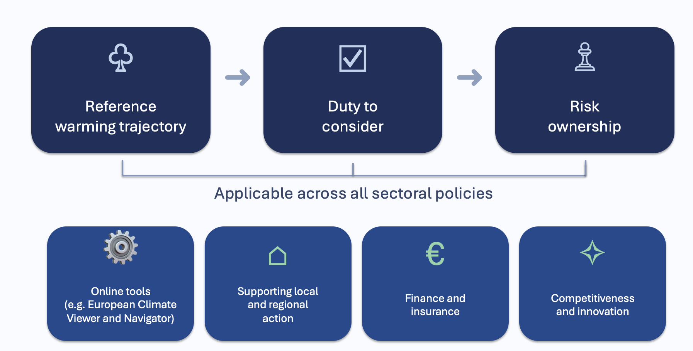
Climate resilience by design

Slide 6
EU level: continent climate resilient by 2050
National: adaptation strategies and plans
Regional/local
Feel impacts
Need to act
→ Bridge the gap between EU and regions: EU Mission on adaptation to climate change
Notes:
Links: between
EU ambition: continent resilient by 2025
The way it is translated into law via MS (classical way of EU)
Reality: regions and local authorities

Slide 7
The EU Mission on Adaptation to Climate Change

Slide 8
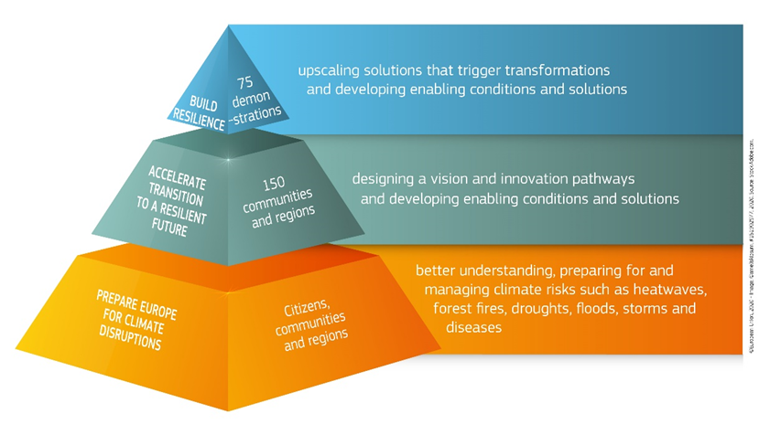
Mission objectives
To support at least 150 European regions and communities to become climate resilient by 2030
III
II
I
Placed-based – systemic – inclusive
Notes:
Topic 6 target objective 2 - Testing and demonstrating transformative solutions on climate resilience, mainstreaming nature based solutions in the systemic transformation

Slide 9

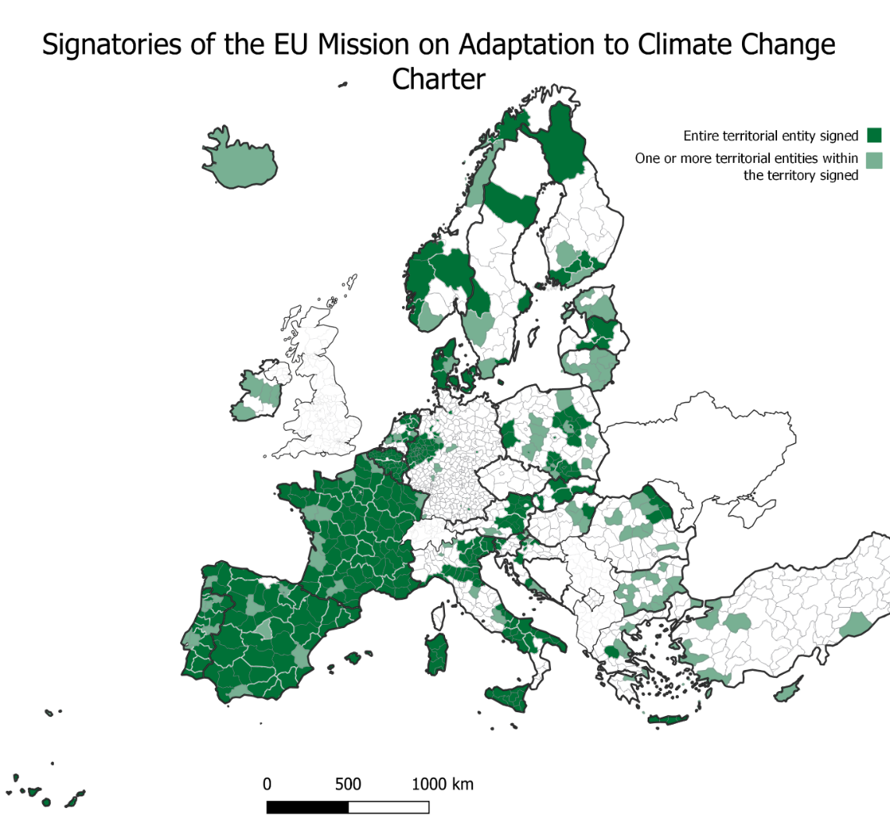
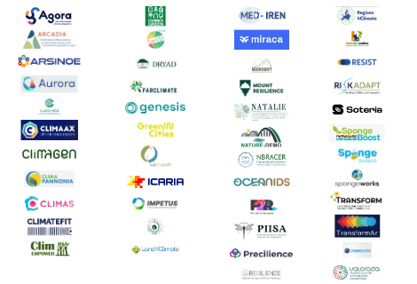
How the Mission works
65 Research & Innovation Horizon Europe projects
333 Regions & local authorities committed through the Mission Charter
MIP4Adapt
Coordination & overall support for Mission implementation
AdaptationHubs
REGILIENCE+

Slide 10
September 2026 Mission Assessment
Target of 150 regions surpasses – currently 292 implementing climate adaptation measures
The Climate Adaptation Mission has mobilised one of the largest climate resilience coalitions ever assembled at EU level, working directly with more than 600 regions and local authorities.
The Mission currently supports 185 regions and local authorities that demonstrate nearly 1 000 innovative adaptation solutions in real-life condition.

Slide 11
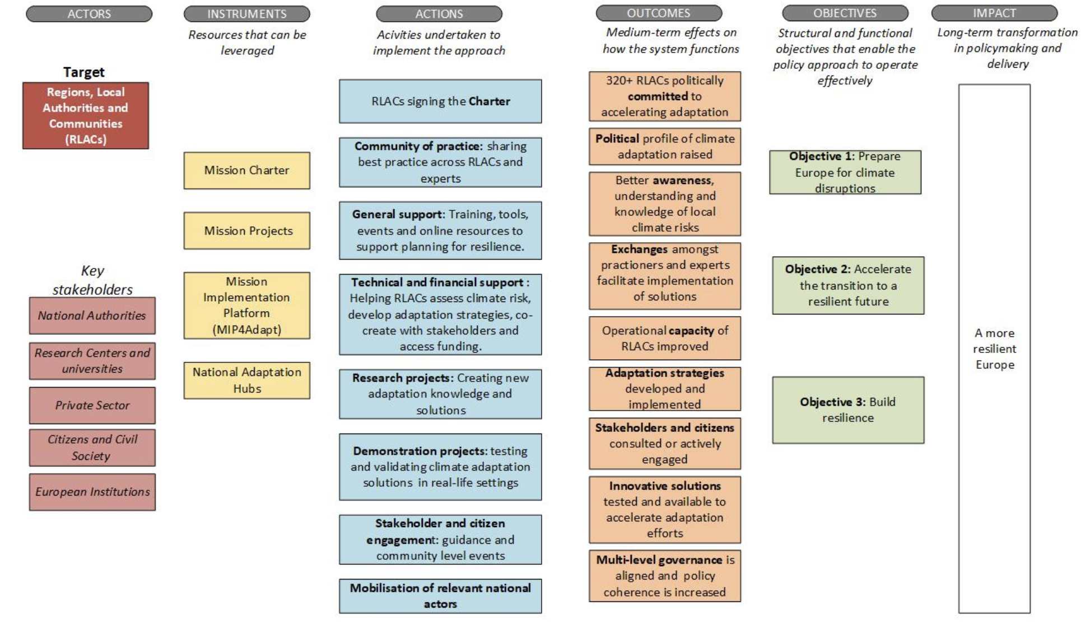
Impact Logic

Slide 12
Projects

Slide 13
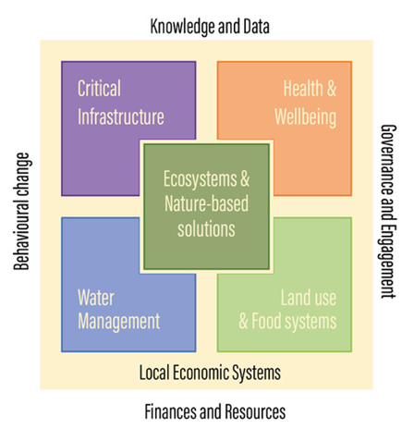
Research projects
Create new knowledge essential for adaptation efforts
Citizen engagement Tools
Adaptation financing Insurance Monitoring
Critical infrastructure
Transformative approaches
Notes:
Various topics addressed

Slide 14
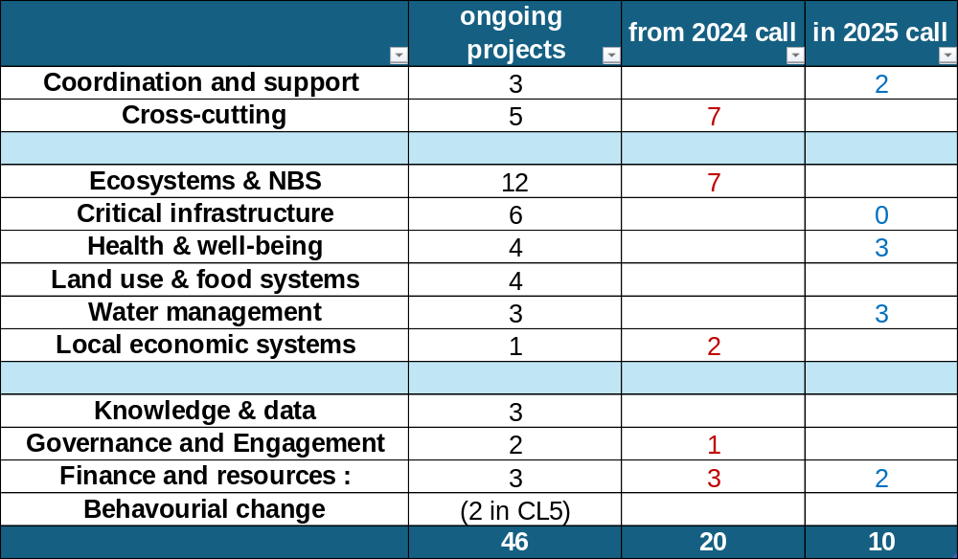
Mission Portfolio - overview
  Mission Portfolio is now made of 65 projects, including :
6 finished projects (as of March 2026)
42 ongoing projects
19 new projects (from the 2024 call)
10 projects under Grant Agreement Preparation (from 2025 call)
Mission Projects Catalogue (without 2024 call)
Public dashboard

Slide 15
Different types of Mission projects
Research Projects (RIAs)
Projects cascading funding to regions (FSTP)
Demonstration projects (IAs)
19 ongoing/finished projects
+ 2 from 2025 call
2 ongoing projects
+ 2 from 2025 call
41 ongoing/finished projects
+ 6 from 2025 call
Adaptation hubs
Regilience+
MIP4Adapt
Coordination

Slide 16
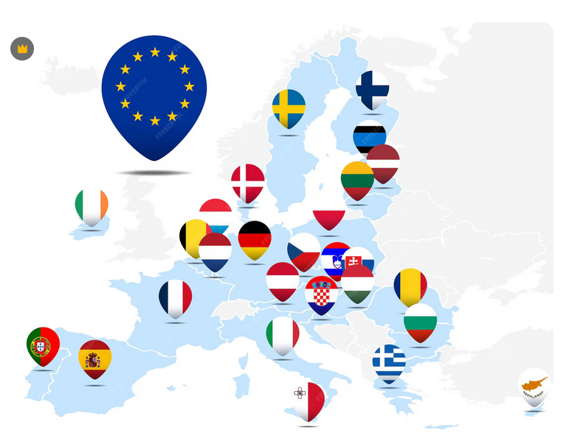
Adaptation Hubs
National structure, flexible, agile and light
with representatives of key national, regional and local authorities & other stakeholders
Foster integration and coherence of climate adaptation
Organise peer-learning
Bring Mission solutions to new audiences
Designed by Freepik

Slide 17
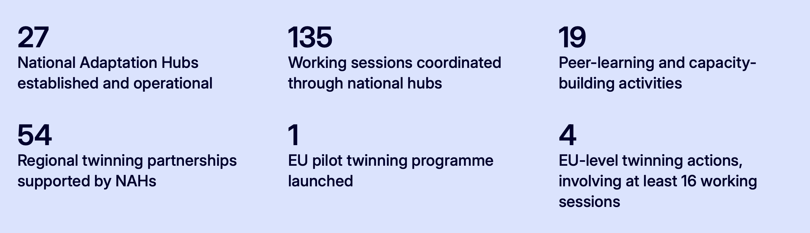
Adaptation Hubs
Ministry-led or government-anchored hubs: Embedded in national adaptation governance, often supported by technical agencies (DE, FR, FI, LT, HR, CY, RO).
Existing platforms and networks: Building on established adaptation programmes, knowledge platforms or coordination structures (DK, SE, ES, NL, AT).
Local government and regional networks: Anchored in municipal associations or regional implementation structures, prioritising local adaptation delivery (LV; partly EL).
Multi-stakeholder partnerships: Emerging networks facilitated by NGOs, universities, research institutions or independent organisations, with varying degrees of government involvement (IT, MT, EE, HU, CZ, PL).

Slide 18
Coordination of Mission actions
Mission Implementation Platform (MIP4Adapt):
acts as the overarching umbrella, facilitates exchanges of best practices animating the Community of Practice
Regilience +:
collects knowledge from the Mission Projects and translate it in useable products for the Mission stakeholders
National Adaptation Hubs:
facilitates the Mission take up and triggers the national implementation in each MS

Slide 19
General Support & Community of Practice(MIP4Adapt)
Selected tools & resources

Slide 20
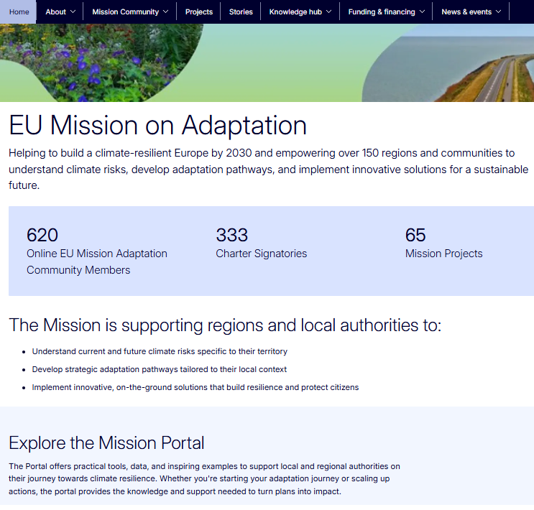
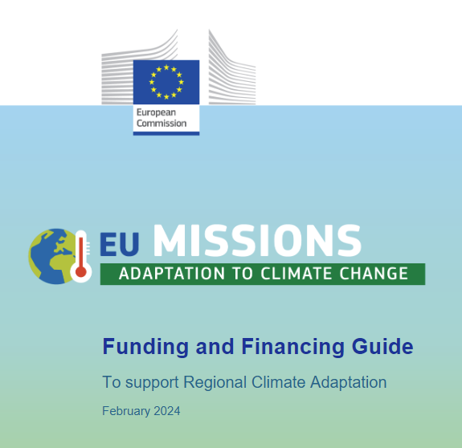
Resources for regions
The Mission Portal
Tools Database
Public funding database & Guide

Slide 21
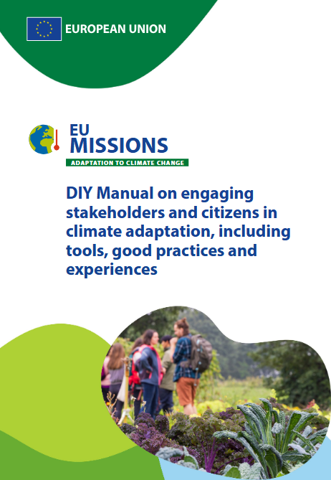
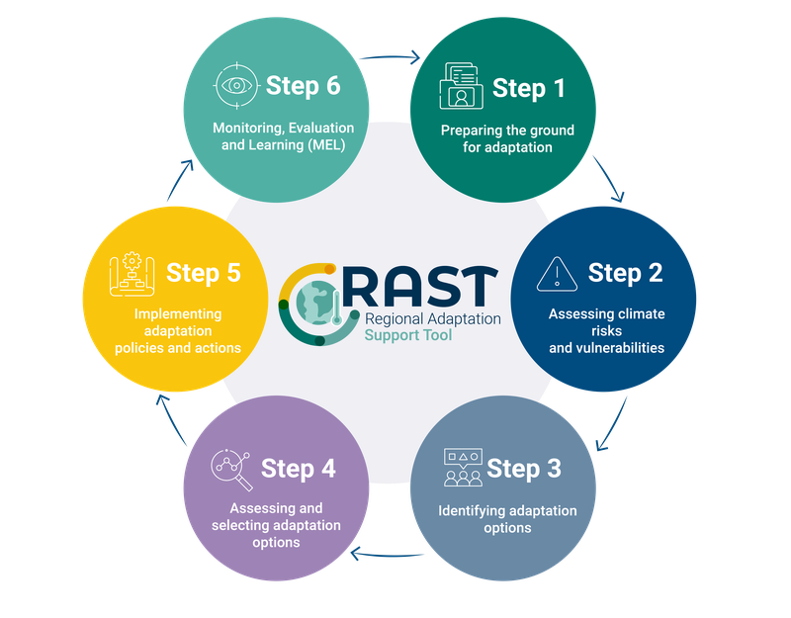
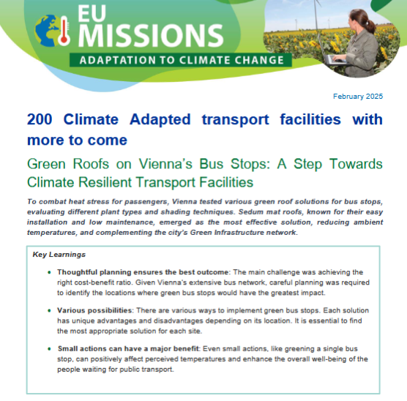
Resources for regions
Citizen
& stakeholder engagement
Adaptation Stories
Regional Adaptation Support Tool

Slide 22
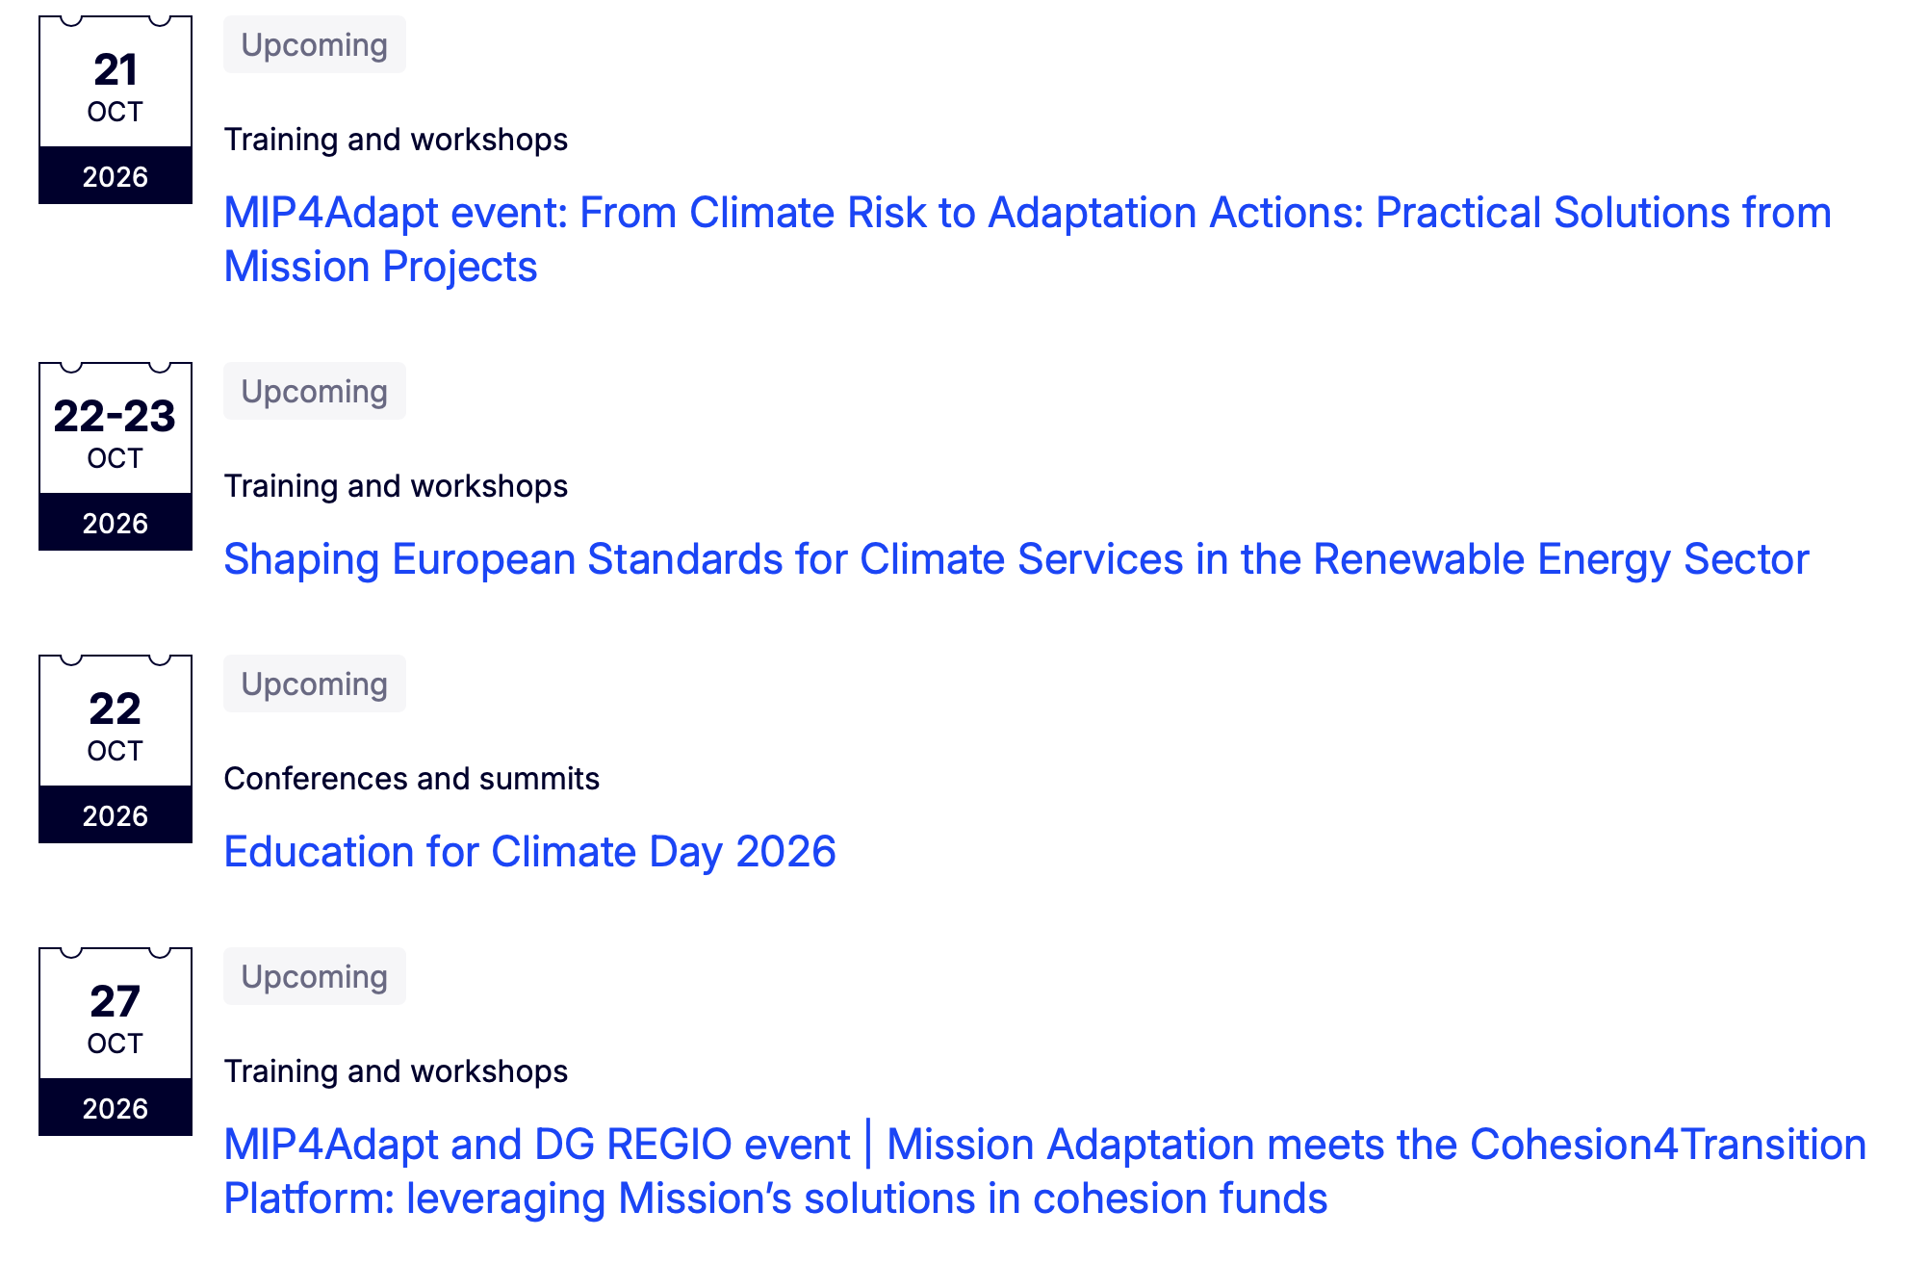
Events and Training
2-3 online events per month (by MIP4Adapt)
Material and information available on EU Mission Adaptation Community
Notes:
Section lead: Ximena

Slide 23
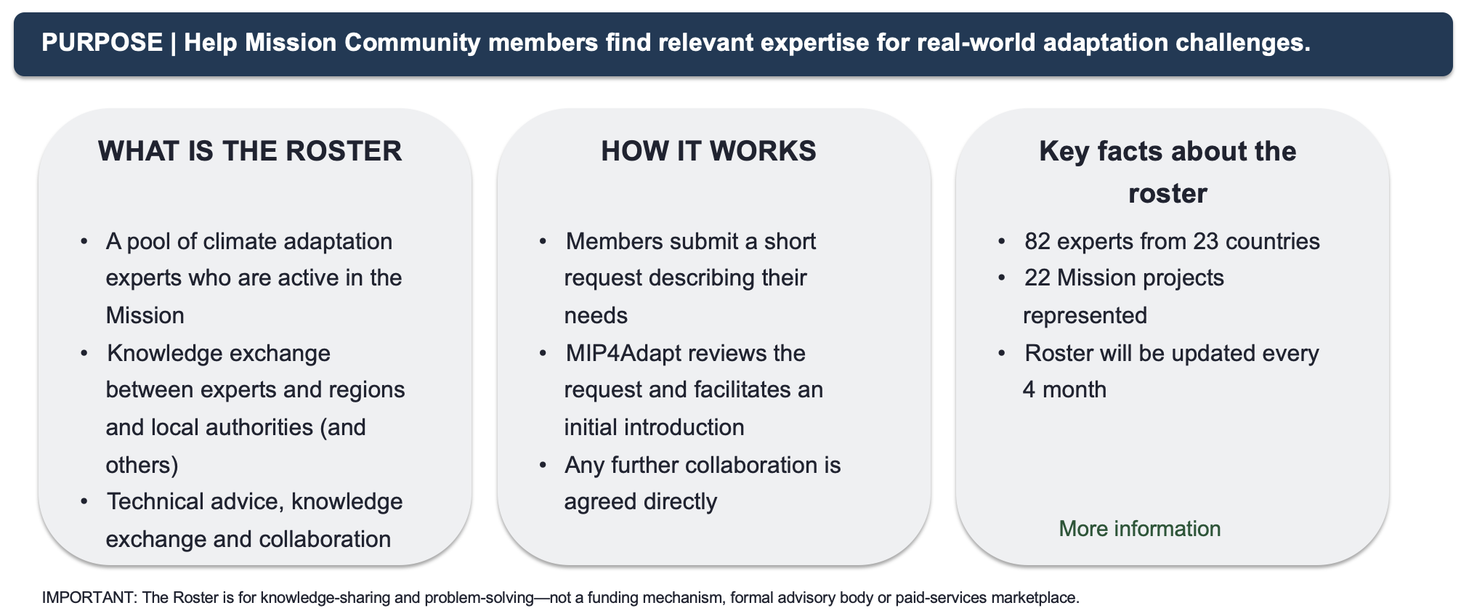
Roster of Experts – launched 14 September

Slide 24


Get involved with the Mission
Mission Newsletter​
The monthly newsletter allows readers to keep up to date with the latest activities from MIP4Adapt, the Mission Projects and the most recent developments in climate adaption. Submit your content for consideration in the next issue!
Social Media
@mip4adapt.bsky.social
@Mission Implementation Platform for Adaptation to Climate Change (MIP4Adapt)
*New* Mission Portal
https://mission-adaptation-portal.ec.europa.eu/
Community of Practice
Events & training | chat room | space for collaboration
EU Mission Adaptation Community | Futurium (europa.eu)

Slide 25
More information about the Adaptation Mission
2025 Activity Report of the Adaptation Mission
2025 Catalogue of Mission Projects
Interactive Dashboard → 271 Adaptation Projects, funded by the Mission and beyond

Slide 26
Upcoming opportunities

Slide 27
Horizon Europe calls
2027 (closing 21 Sept 2027)
Remaining opportunities: 2026–2027
HORIZON-EIC-2026-ACCELERATOR-01
Cross-border resilience (5)
Demonstration
Deep Tech for Climate Adaptation
Deadline: 04/11/2026 (full proposal)
CLIMA-CIT-CCRI
Wastewater (3)
CLIMA-CIT-NEB
Urban nature (4)
Budget: €50 million
Research
HORIZON-BRIDGING-2027-04-03
Artificial Intelligence (5)
Bringing innovative climate preparedness and
resilience solutions closer to the market
Deadline: 16 Feb 2027, 17:00 Brussels
Coordination & Support
Budget: €20 million for 1 project
HORIZON-HLTH-2027-01-ENVHLTH-MISSCLIMA-03
Tools and technologies to support health
adaptation to climate change
CLIMA-HLTH
Pre-commercial procurement Health (1)
Other
Deadline: 17 Feb 2027, 17:00 Brussels
Budget: €20 million for 4 projects

Slide 28
Support for regions and local authorities
What | Provider? | For whom? | When?
Tailored Support to organise local citizen events | MIP4Adapt 2.0 | Signatories | Deadline: 15 May 2026 New call in 2027
Citizen Engagement Hotline Service | MIP4Adapt 2.0 | Signatories | on demand
Financial Support – assessing climate risk | Follow-up CLIMAAX | Open to all – for min 50 regions | Will open in 2027
Financial Support – Adaptation Plans | Follow-up P2R | Open to all – For min 70 regions | Will open in 2027
Twinning projects | AdaptationHubs (national & EU) | Open to all | Rolling basis

